Slide 1


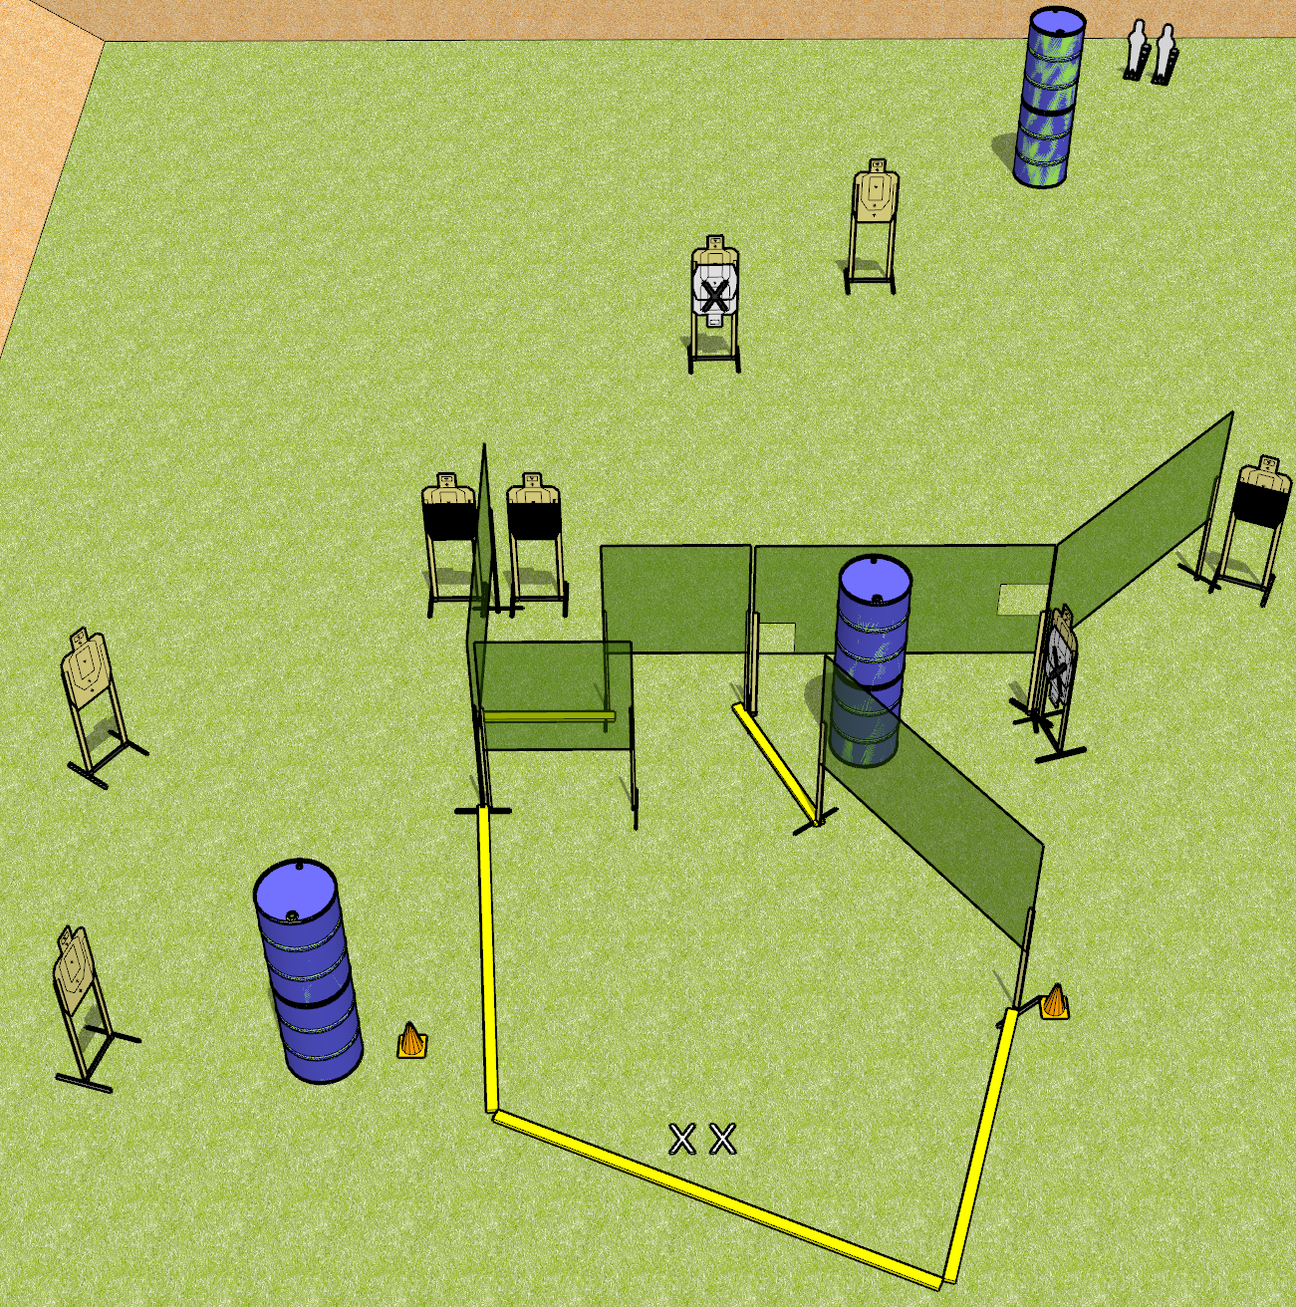
 | Dothan Gun Club – USPSA Match Crowd the Plate Course Designer : Drew Coleman
START POSITION : Standing with both feet on X’s, wrists below belt
GUN READY CONDITION : Pistol loaded and holstered. PCC loaded, held with both hands, shouldered, safety on, pointed at orange cone. |  | SCORING: Comstock, 18 rounds TARGETS: 8 paper, 2 Steel SCORED HITS: Best 2 on paper, steel until down START-STOP: Audible, last shot RULES:
STAGE PROCEDURE: Engage targets as they become available from within the fault lines.

Slide 2
Crowd the Plate
Written Stage Briefing
Crowd the Plate is an 18 round, 90 point, Comstock medium course. There are eight USPSA targets and two mini poppers. The best two hits on paper will score, and steel must fall to score. The start signal is audible.
Handgun start position is both feet on X’s, wrists below belt. Handgun is loaded and holstered.
PCC start position is both feet on X’s, muzzle pointed at either orange cone. Loaded carbine is held with both hands, safety on, shouldered.
On start signal, engage targets as they become available from within the shooting area.

Slide 3
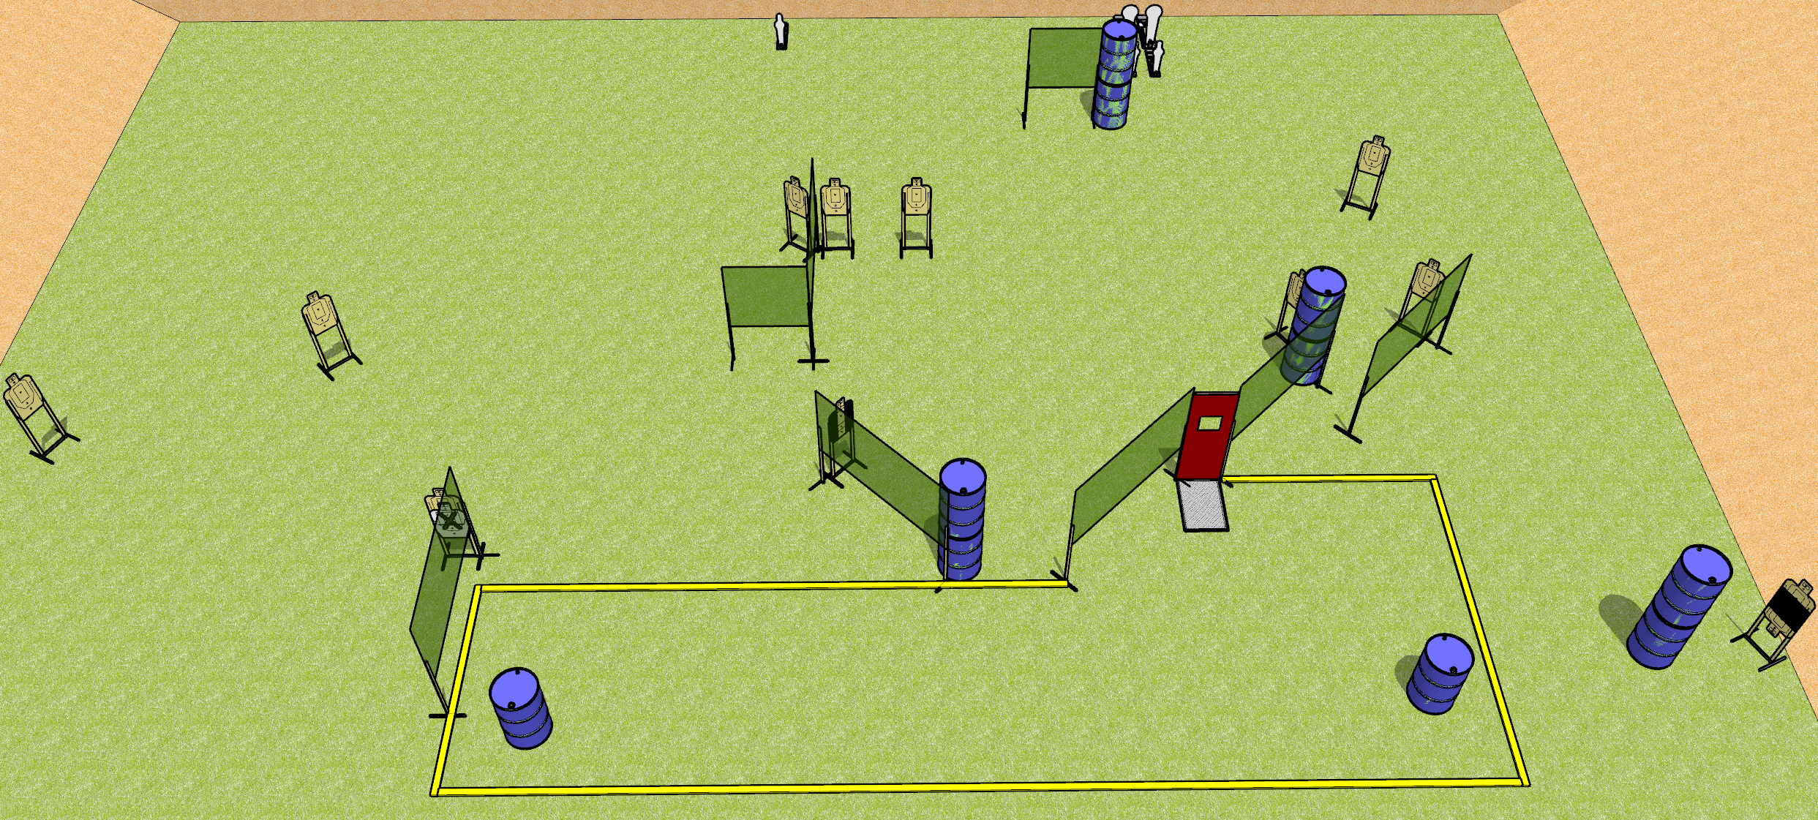
 | Dothan Gun Club – USPSA Match Get Some Course Designer : Drew Coleman
START POSITION : Anywhere in the shooting area, back straight, wrists above shoulders.
GUN READY CONDITION : Firearm placed on either barrel in the shooting area. Firearm is loaded, unsupported, safety on. |  | SCORING: Comstock, 29 rounds TARGETS: 12 paper, 5 Steel SCORED HITS: Best 2 on paper, steel until down START-STOP: Audible, last shot RULES:
STAGE PROCEDURE: Engage targets as they become available from within the fault lines.

Slide 4
Get Some
Written Stage Briefing
Get Some is a 29 round, 155 point, Comstock field course. There are twelve USPSA targets, three mini poppers, and two colt poppers. The best two hits on paper will score, and steel must fall to score. The start signal is audible.
Start position is anywhere in the shooting area, back straight, wrists above shoulders. Handgun or PCC is loaded, safety on, laying flat on either barrel in the shooting area. Muzzle is pointed down range.
On start signal, engage targets as they become available from within the shooting area.

Slide 5
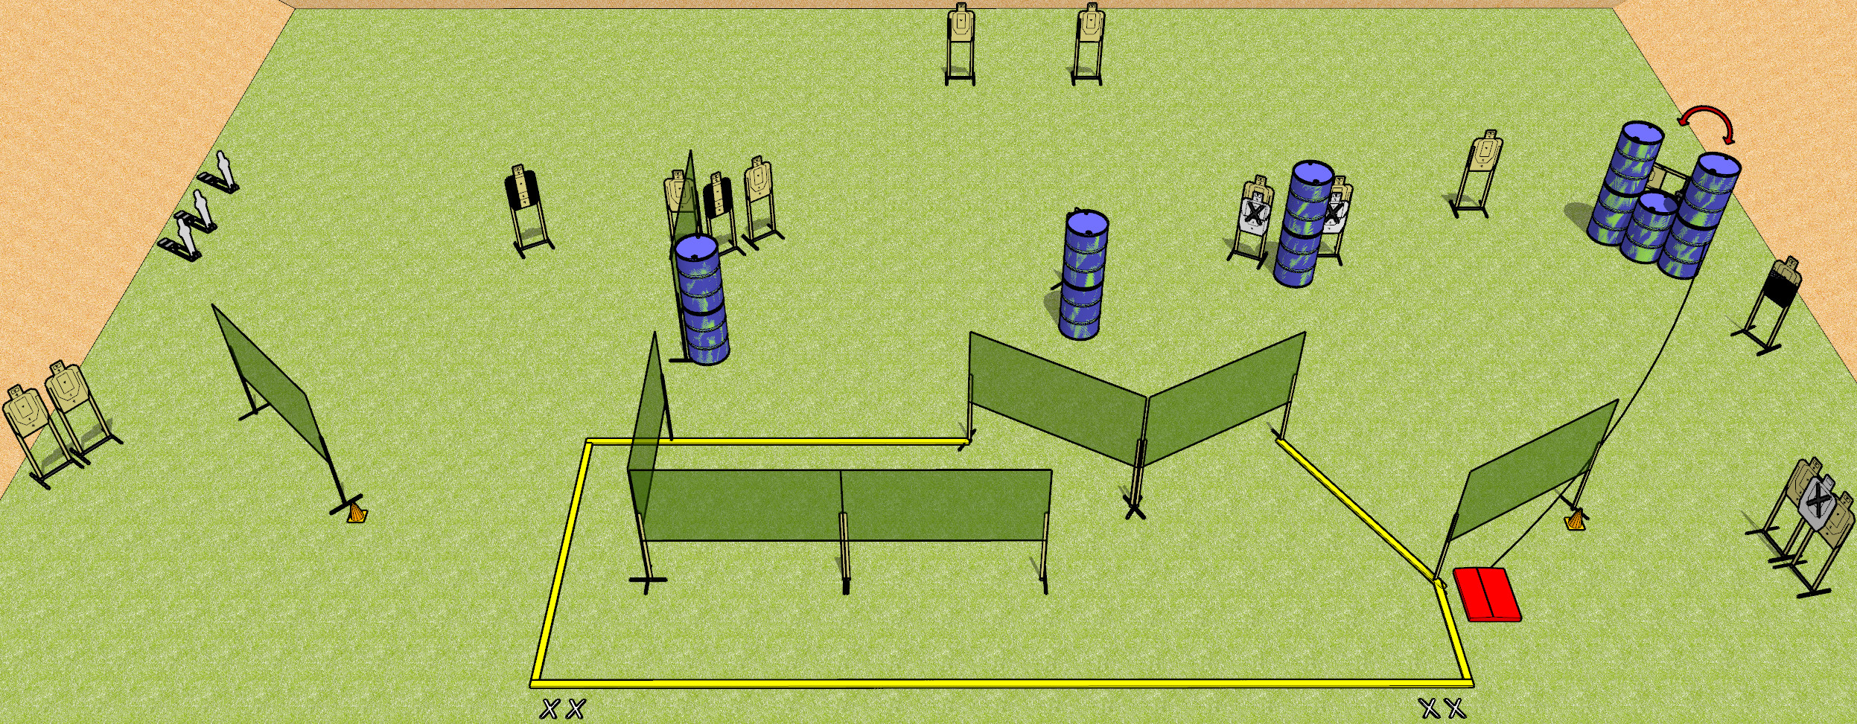
 | Dothan Gun Club – USPSA Match Clusterfuck Course Designer : Drew Coleman
START POSITION : Standing with both feet on either set of X’s, wrists below belt
GUN READY CONDITION : Pistol loaded and holstered. PCC loaded, held with both hands, shouldered, safety on, pointed at either orange cone. |  | SCORING: Comstock, 35 rounds TARGETS: 16 paper, 3 Steel SCORED HITS: Best 2 on paper, steel until down START-STOP: Audible, last shot RULES:
STAGE PROCEDURE: Engage targets as they become available from within the fault lines.

Slide 6
Clusterfuck
Written Stage Briefing
Clusterfuck is a 35 round, 175 point, Comstock field course. There are sixteen USPSA targets and three mini poppers. The best two hits on paper will score, and steel must fall to score.
The stomp box activates the swinger. Please check the activator prior to walkthrough and set it the same way every time. The swinger is not disappearing.
Handgun start position is both feet on either set of X’s, wrists below belt. Handgun is loaded and holstered.
PCC start position is both feet on either set of X’s, muzzle pointed at orange cone. Loaded carbine is held with both hands, safety on, shouldered.
On start signal, engage targets as they become available from within the shooting area.

